Slide 1
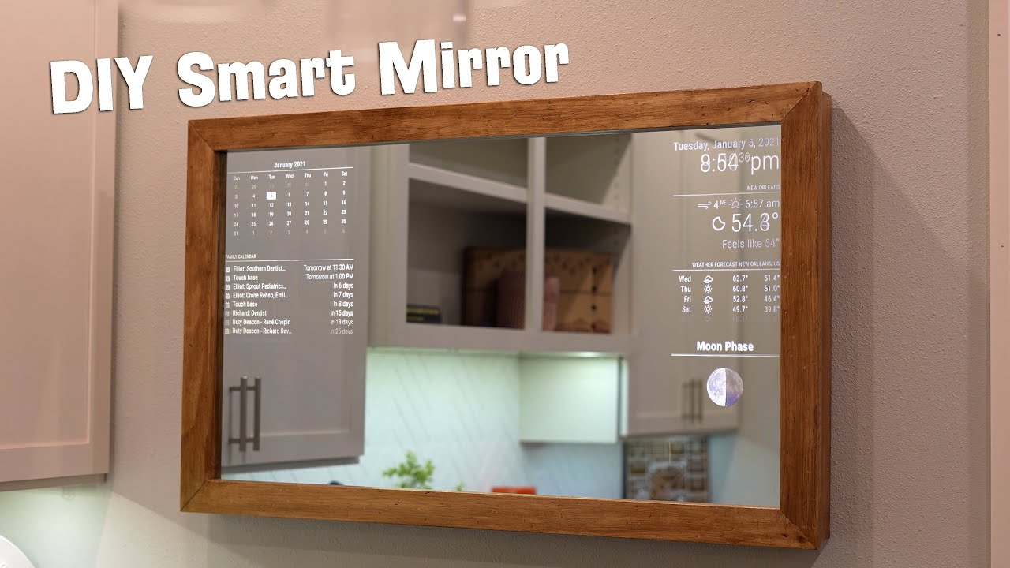
JARVIS MIRROR
By : 1. Mulla, Mehvish (201683918)
2. Devanga A, Vineela (201680186)
3. Bhatt, Balkrishna (201673048)
4. Mathew, Christeena (201631941)
5. Sara Sabu, Angeline (201684974)
6. Pinheiro, Avelin Mary (201648465)

Slide 2
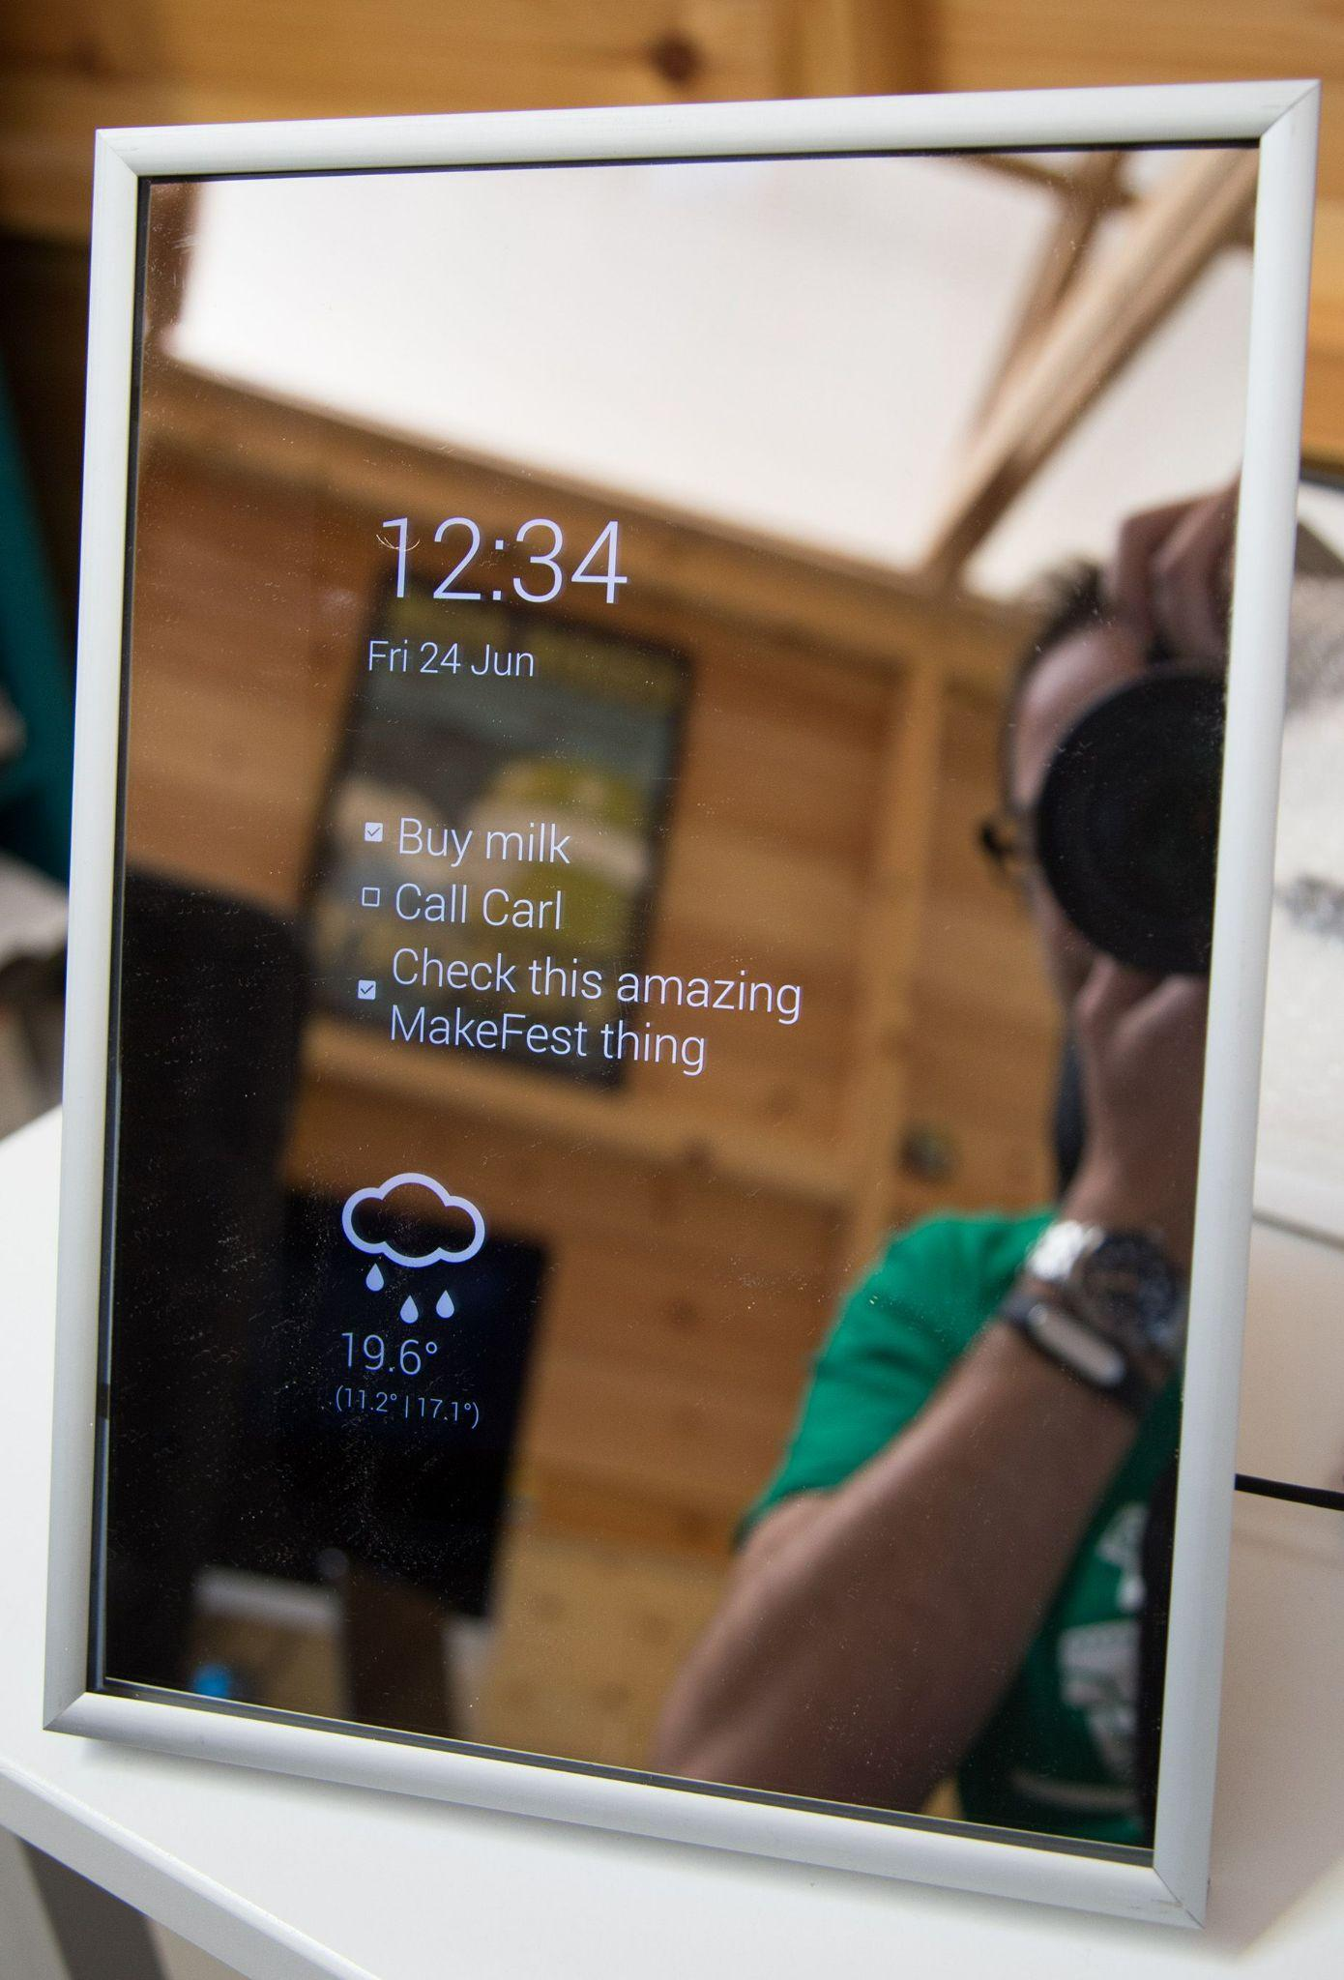

Slide 3
Introduction
With developments in science and technology, we are moving toward a more automated and interconnected way of life.
Rapid technological advancement necessitates the need for home automation projects.
It's helpful to have a single station from where many widgets like calendar , time , weather or news can be viewed , while at the same time using it in our daily routine.
With the JARVIS mirror, we made it possible to get dressed simultaneously by reading the news or checking the weather/maps/time.

Slide 4
Project Objective
To help people with efficient time management in their day to day life.
Users will be able to access features like news , calendar, weather etc simultaneously while using mirror just by asking for it .
The mirror can be used for providing means of entertainment , such as when the user asks "Tell me a joke" which triggers the audio output and displays the text on mirror.
Provides navigation and calculation of time for travel based on geographic location.
Improves clothing retail chains by using innovative technology such as smart mirror fashion technology.

Slide 5
Project Scope
Provides user-mirror interaction
Empowers disabled persons to easily access essential requirements from a single interactive device.
Using augmented reality to offer the user wardrobe and hairstyle suggestions.
Displaying maps using Google Maps API key.
Additionally, the JARVIS mirror can be upgraded to show social media and online browsers. By including a motion sensor in the mirror, we can improve both speed and usability.

Slide 6
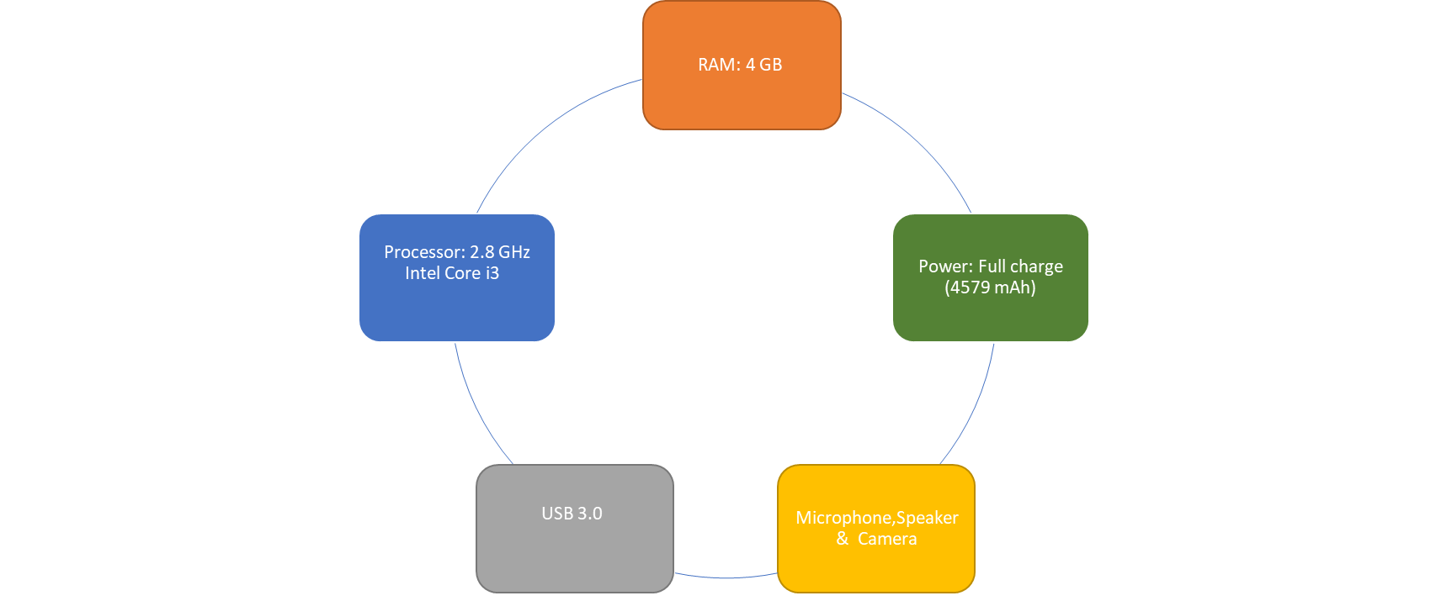

Requirement Specification
The Jarvis mirror will be run through a system that takes in the data from the various devices and peripherals which in turn are used to provide the user with the information that are needed by user. The general hardware specifications for this system are provided :

Slide 7
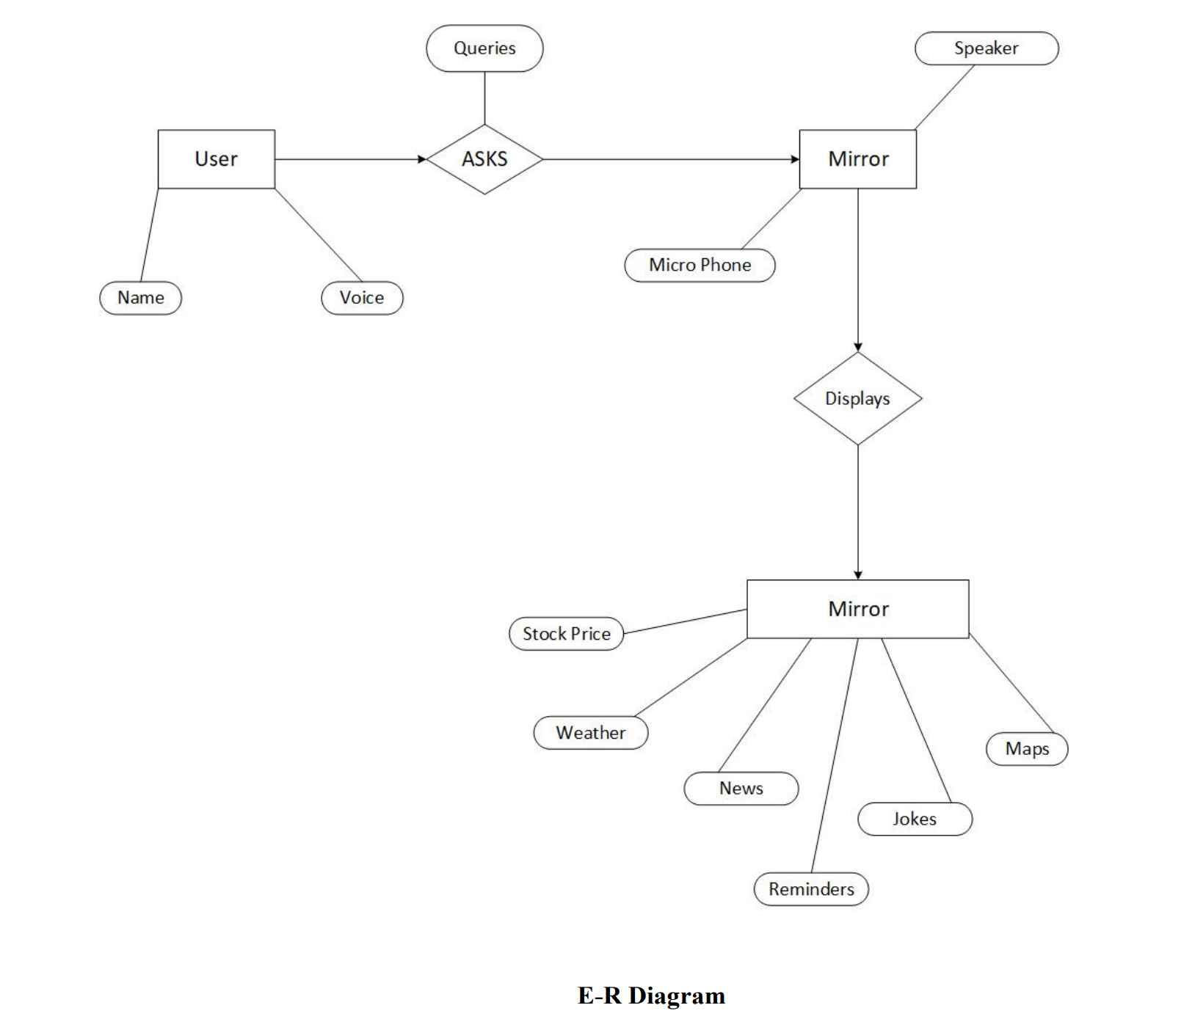
E-R D I A G R A M

Slide 8
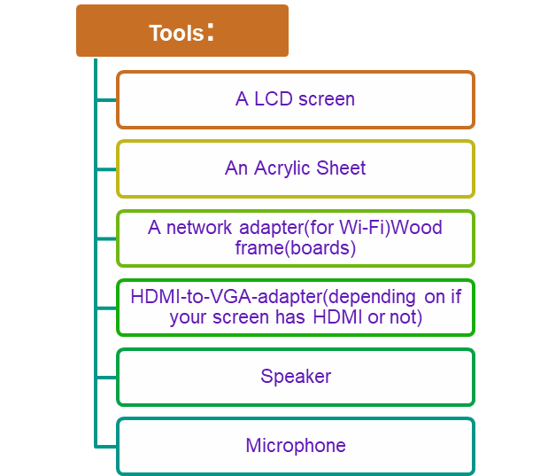
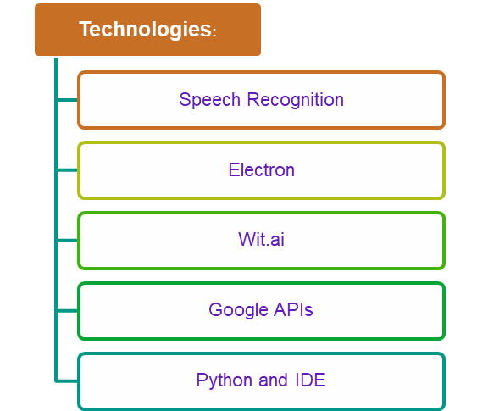

Slide 9
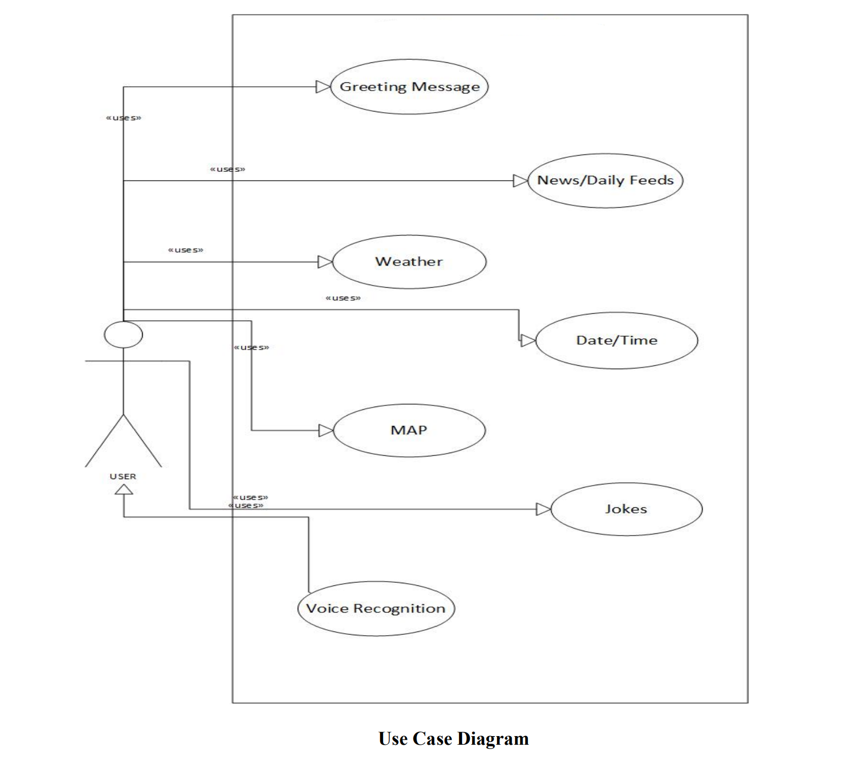
High Level Design (Use Case Diagram)

Slide 10
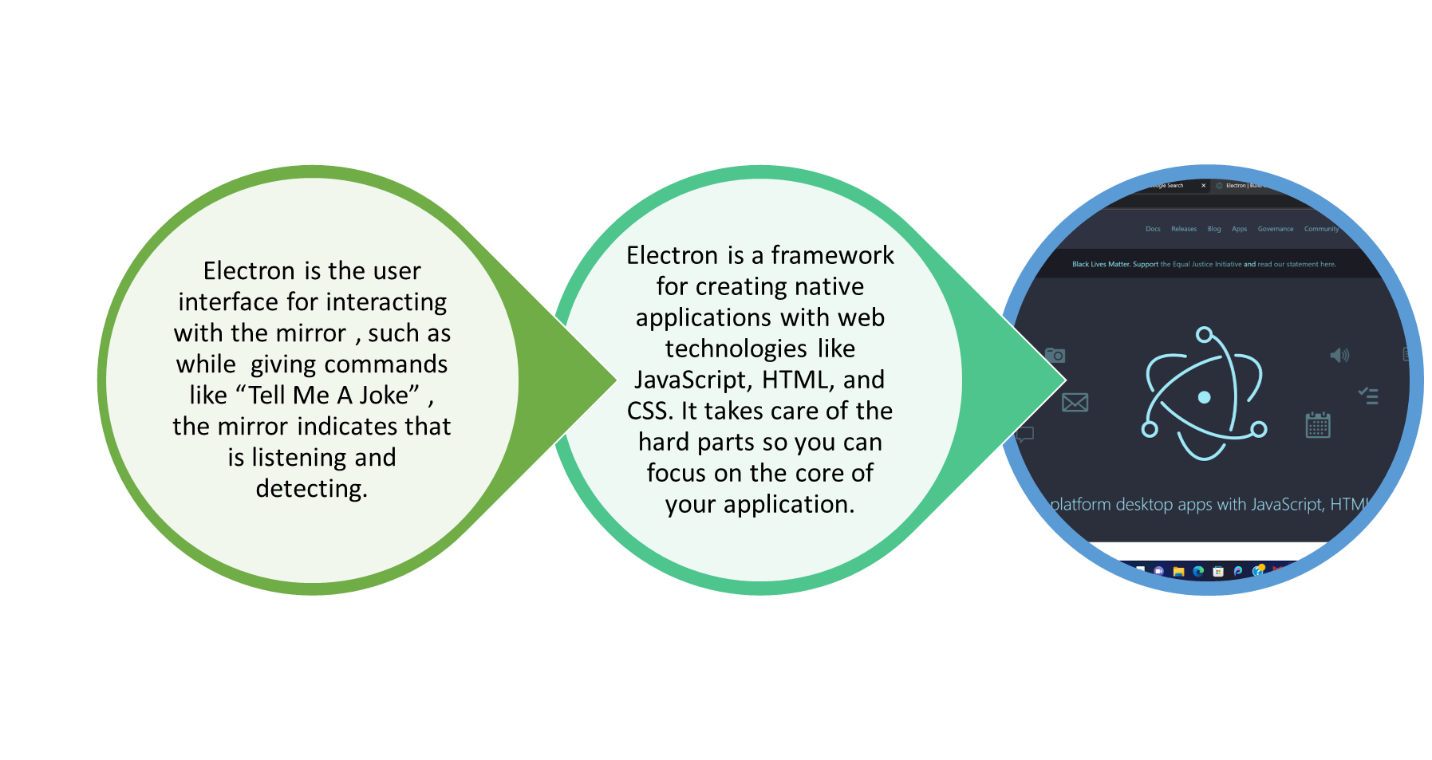
Electron

Slide 11
Joke
When users says the phrase “Tell Me A Joke”, the joke will be fetched and displayed and also played through the speaker.
Natural language processing (NLP) uses machine learning to reveal the structure and meaning of text. We use NLP to detect what the user is speaking , which is then converted to text.
Wit.ai is an open source chatbox framework .It can parse the text and return informed responses.
In case of “Tell Me A Joke” , Wit.ai will analyze the text and find the keyword ‘joke’, this will be used to fetch the joke from the python library.·
Google NLP’s text to speech converter will be used to play the joke as audio.

Slide 12
Modules
JARVIS! : This module is used for activating the mirror. When the user stands in front of the mirror and says the hotkey “JARVIS!” , the mirror is triggered and responds to user by greeting them with “Good Morning Tony” etc.
“JARVIS” is the system’s wake up phrase . The mirror is always in listening mode through the mic. When user utters the phrase , the mirror catches it and verifies on Google Cloud. Then the mirror gives the appropriate greeting to user.

Slide 13




Maps: This is the module in which when the user asks for the navigation the mirror will display the maps of specific types like “Hybrid”, “Terrain” and “Satellite”. The mirror will also display the map of specific city.
USER
Google Cloud speech to text
wit.ai
Google maps

Slide 14
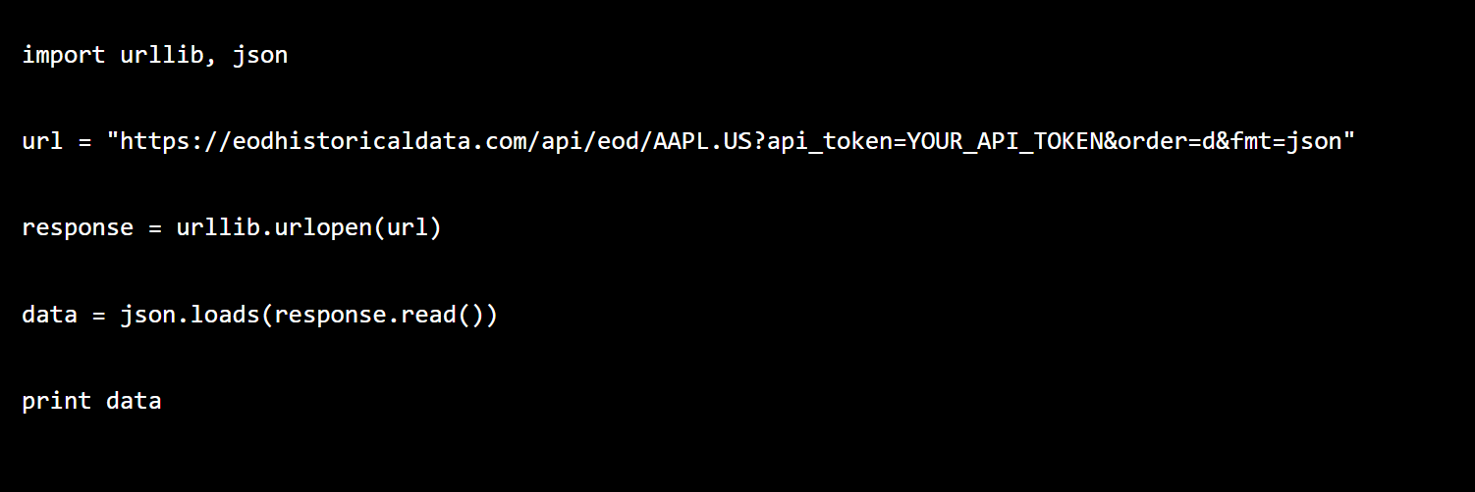
Modules
Stock Price: In this module, the user will be able to fetch the stock price whenever he needs it. It will fetch the basic stock price and display different cases scenarios like “High”, “Low”, “Open” and “Close”. We have used open source stock price API -EODHD API to get Stock Market Prices, Splits and Exchanges (Stock Market) Financial APIs.

Slide 16
Modules
Weather: In this module the user will be able to fetch the weather. The weather will be available for every specific city. The user will be able to fetch the forecast for the next three to seven days. Here we are using meteomatics open source api key to get weather data.In order to access weather data from the API as convenient as possible, Meteomatics offers sample code and open source Python modules for the easy retrieval of any type of weather data.
According to the REST standard, data can be queried using HTTP-GET or HTTP-POST requests from api.meteomatics.com. A request can be constructed using the format:
https://api.meteomatics.com/<validdatetime>/<parameters>/<location>/<format>?<optionals>
Example: https://api.meteomatics.com/2022-11-09T00:00:00ZP1D:PT1H/t_2m:C,relative_humidity_2m:p/47.4245,9.3767/html?model=mix

Slide 17
Modules
Reminders : One can ask the mirror to display reminders for any day, following which the reminders would be displayed on the mirror and the same would be conveyed through the speaker.
Google Calendar API will be integrated to Electron User Interface and this will enable user to view reminder.
When the user asks “ Show me reminder” - the Google speech to text convertor and wit.ai parsing will be used to detect and analyze the user request.

Slide 18
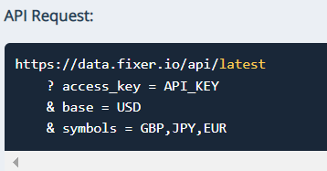
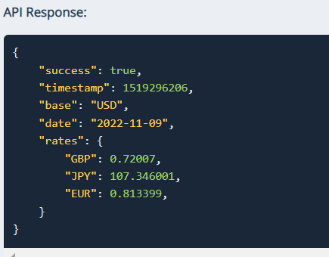
Modules
Currency Converter: In this module the user will be able to convert currencies and we use ‘Fixer’ open source currency convertor API for this, it returns data in JSON format which can be easily parsed using Python.

Slide 19
Future Scope
We Can add a VR model in which this mirror shows user how they are looking in particular clothing. This use case is for big shopping malls in which brands can put mirrors for customers.
For further expansion we thought about Gesture enabled operation in mirror for example with simple hand motion user can interact between multiple screens.

Slide 20
Conclusion
So, dreams about a better future are always filled with gadgets. With the help of Jarvis mirror we are getting accessible interaction with the gadgets.
All the other mobile gadgets like phones, computers, tablets etc expose the inside of your brain in a way that's bad. So human beings need something which is not very mobile and yet gives you all the necessary information. The Jarvis mirror is something we can say fulfilled that condition.
It is imperative that JARVIS mirrors are included in the fashion and grooming industry. Furthermore, it is very useful for people with disabilities. It is a very cost-effective product since all open-source libraries have been used.

Slide 21
References
http://blog.litstudios.com/index.php?/archives/14-Interactive-Mirror.html
http://www.tofsen.se/articles/30/revolutionizing-your-bathroom-experience
http://www.extremetech.com/computing/94751-the-new-york-times-magic-mirror-willbring-shopping-to-the-bathroom
http://www.cybertecturemirror.com/main.php?id=home
http://www.engadget.com/2010/10/13/cybertecture-mirror-reflects-our-fantasies-looksset-to-become/
http://www.theverge.com/2012/5/10/3013168/seraku-android-mirror-prototype-hands-on
http://www.youtube.com/watch?v=uF0NSUmxFYA
http://blog.seattlepi.com/microsoft/2010/11/05/the-guts-of-microsofts-kinectsensor/
http://www.cpelectronics.co.uk/

Slide 22
